Slide 1
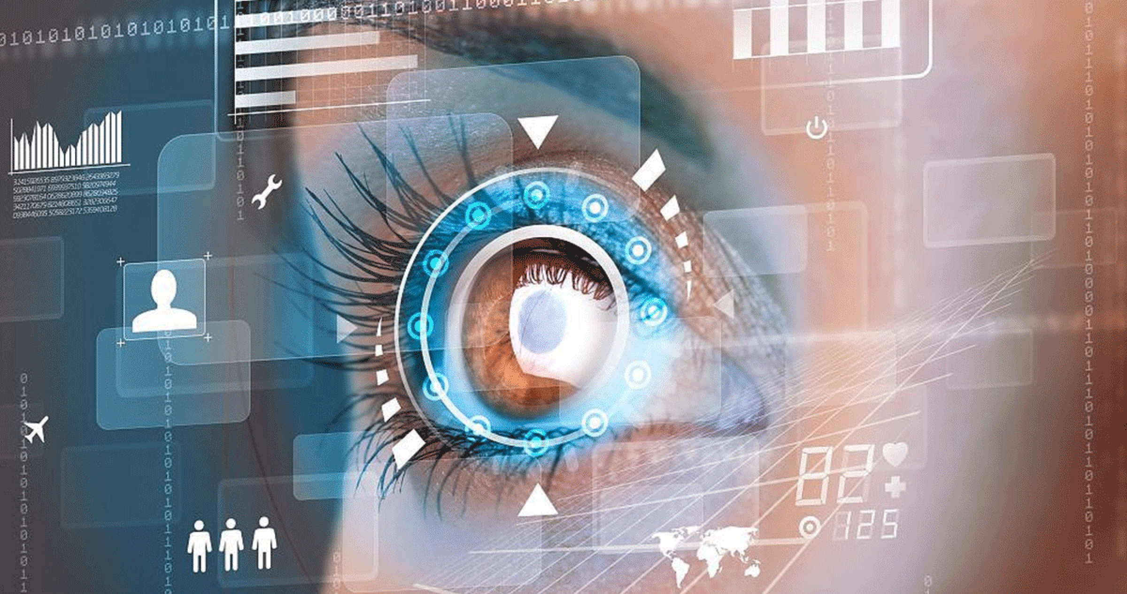
Predicting Visual Search Efficiency Using Eye-Tracking Data.
NAME : N.PRUDHVI HT.NO:2403A510G7
NAME: A.SREEMANTH HT.NO:2403A510G1
NAME: J.ABHIRAM HT.NO:2403A51342
NAME: MD.RAHEL HT.NO:2403A510E2

Slide 2
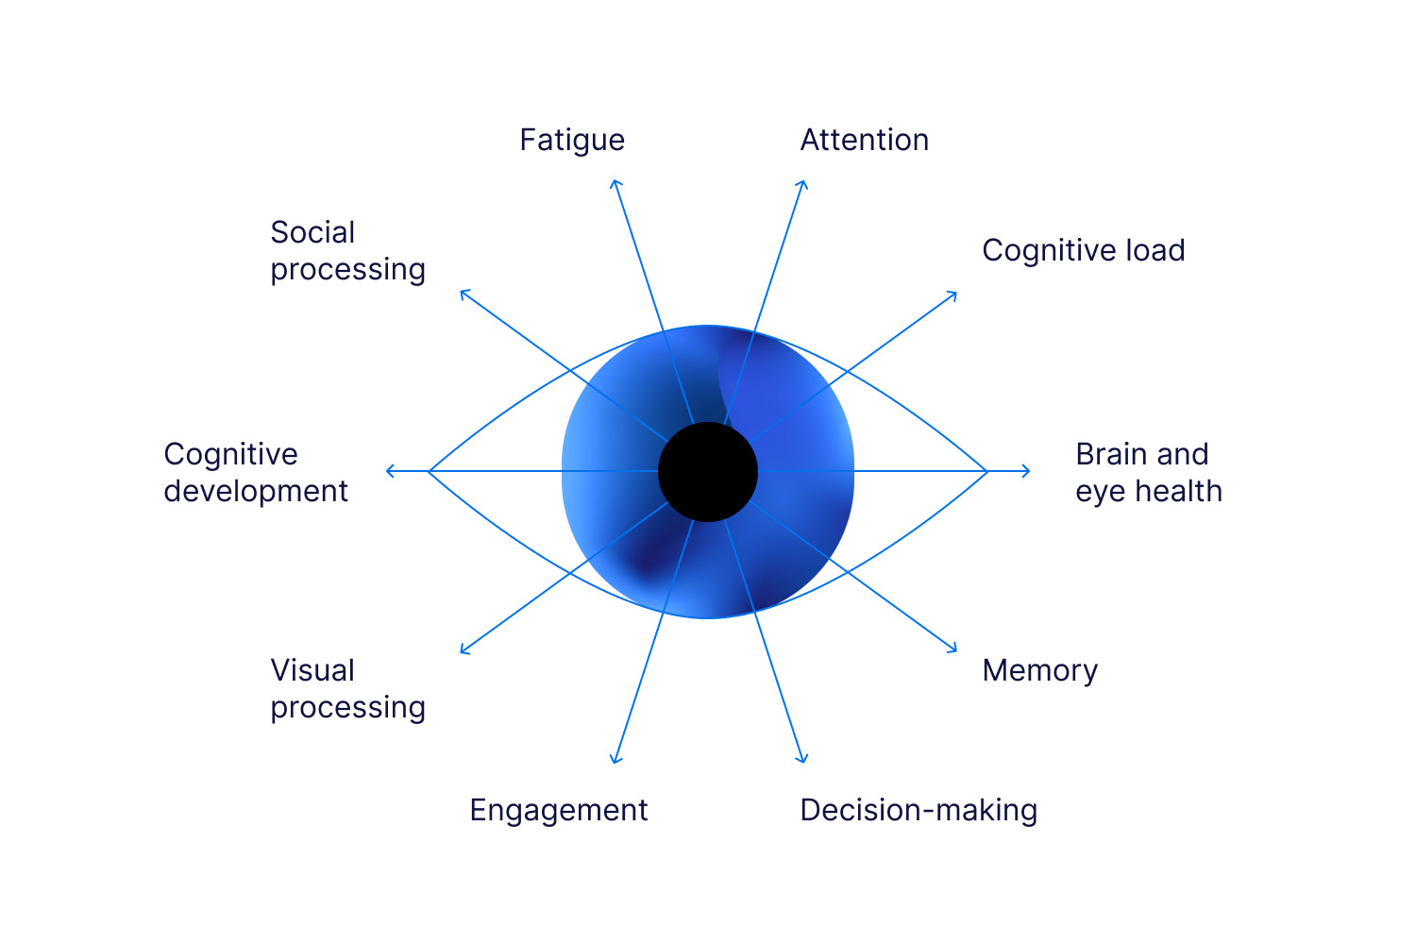
Abstract
Investigates visual search behavior in Human-Computer Interaction (HCI) contexts
Applies eye-tracking data analysis to quantify user attention patterns
Generates heatmaps and scanpaths as visual representations of gaze behavior
Employs machine learning to predict search efficiency from gaze features
Primary goal: inform and improve UI design through gaze-based usability insights

Slide 3
Introduction & Problem Statement
Introduction
Problem Statement
Human-Computer Interaction (HCI) relies on understanding user attention
Visual search behavior reveals cognitive load and interface usability
Eye-tracking provides objective, real-time gaze measurement
User attention patterns are difficult to quantify using conventional methods
Existing tools lack real-time usability insights from gaze data
There is a gap in gaze-based efficiency analysis for adaptive UI systems

Slide 4

Objectives & Literature Review
Objectives
Analyze gaze behavior across visual search tasks
Predict search efficiency using ML models
Provide actionable insights to improve UI design
Literature Review
COCO-Search18 dataset as primary benchmark for visual search
Prior work on saliency models and scanpath similarity metrics
Eye-tracking research establishing fixation and saccade analysis methods

Slide 5
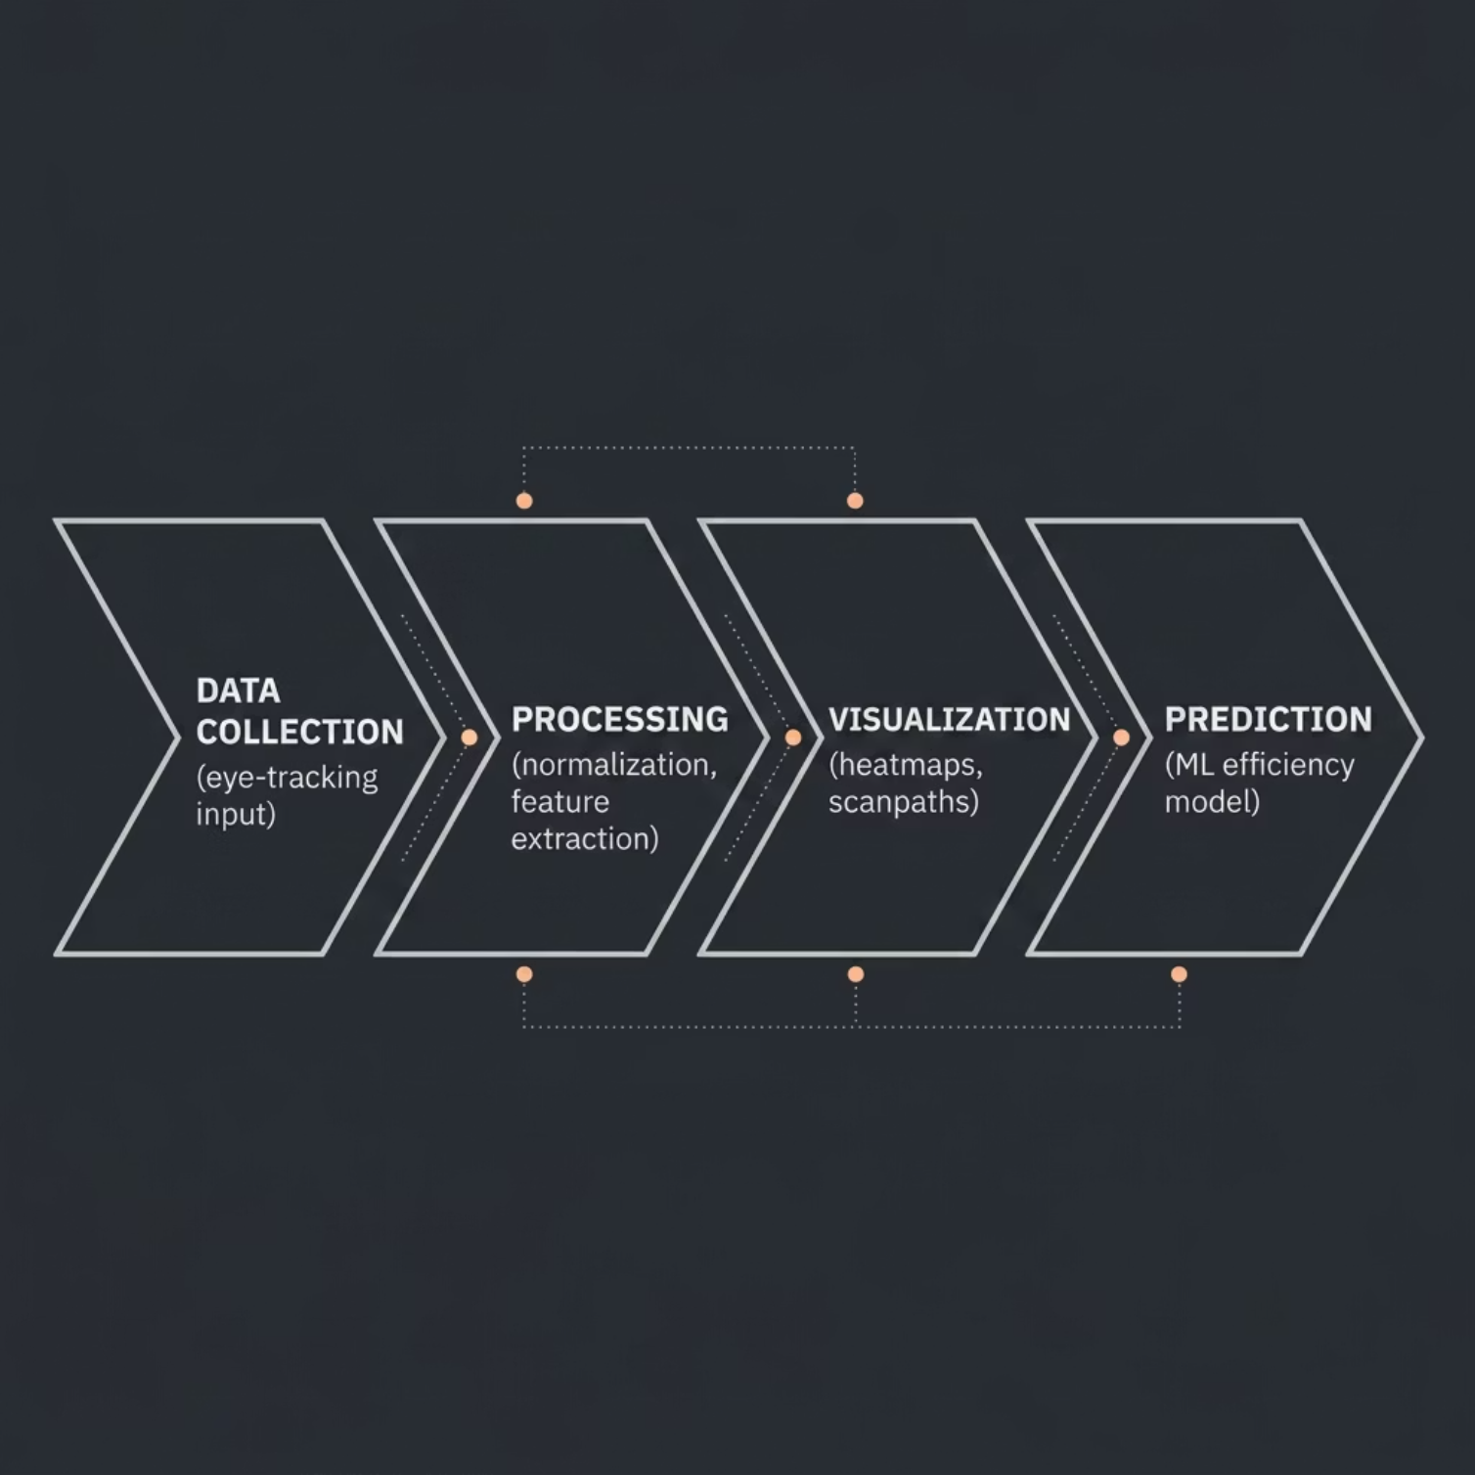

Proposed System & Architecture
System Architecture
Proposed System
Input: Raw eye-tracking data (fixations, saccades, timestamps)
Process: Preprocessing, normalization, and gaze visualization
Output: Search efficiency metrics and UI adaptation recommendations

Slide 6
Methodology
01
02
03
Data Preprocessing
Coordinate Normalization
Heatmap Generation
Raw gaze coordinates cleaned, outliers removed, and synchronized with stimulus frames
Gaze points mapped to a standard coordinate space across varying screen resolutions
Gaussian kernel density estimation applied to fixation distributions
04
05
Scanpath Visualization
Machine Learning Model
Sequential saccade trajectories rendered to capture navigation flow
Supervised classifier trained on gaze features to predict search efficiency

Slide 7
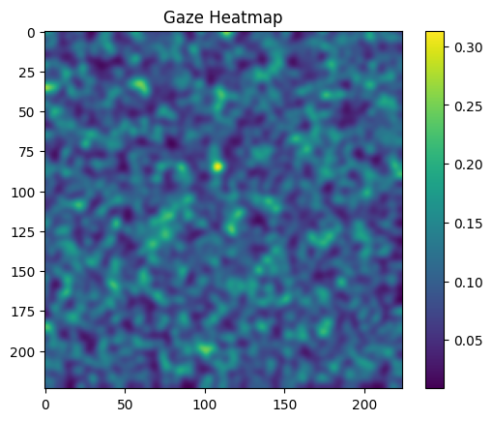
Implementation & Heatmap Visualization
Implementation Stack
Python on Google Colab for reproducible experimentation
NumPy & Pandas for data manipulation and feature engineering
Matplotlib & Seaborn for heatmap and scanpath rendering
OpenCV for image processing and coordinate mapping
Scikit-learn for model training and evaluation
Heatmap Output
Visualizes aggregate user attention across the interface
Highlights high-focus and neglected regions for design review

Slide 8
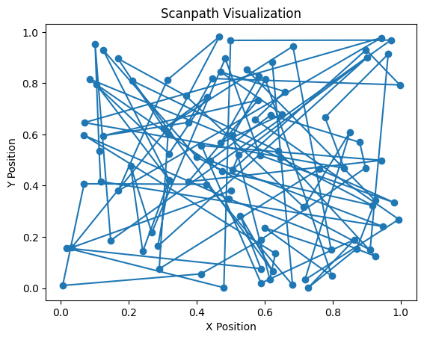
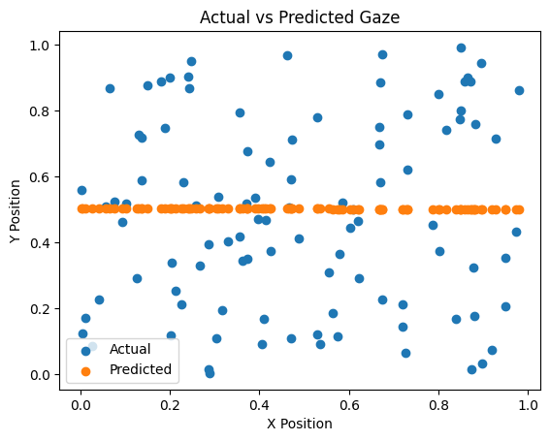
Results, Advantages & Limitations
Results
Limitations
Heatmaps clearly delineate attention concentration zones
Scanpaths reveal navigation flow and search strategy differences
ML model is basic — limited to classical classifiers without temporal modeling
Dataset scope restricted — COCO-Search18 may not generalize to all UI contexts
No real-time inference capability in current implementation
Advantages
Lightweight pipeline — simple and computationally efficient
Directly actionable for UI/UX design improvement

Slide 9
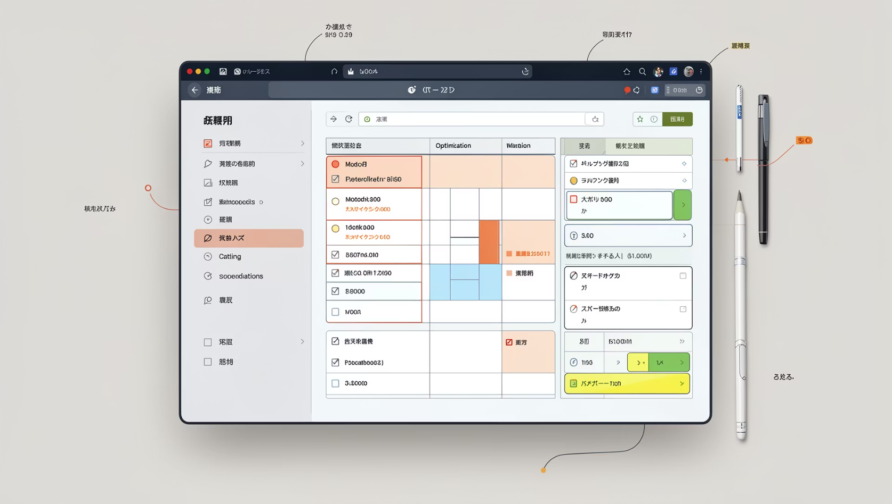
UI Adaptation Logic
Analyze Gaze Patterns
Extract fixation density and dwell time per UI region
Identify High-Attention Areas
Cluster hotspots indicating cognitive engagement or confusion
Detect Inefficient Search
Flag excessive saccades and backtracking as usability signals
Suggest UI Improvements
Recommend repositioning, resizing, or recoloring of elements
Optimize Layout
Iteratively refine interface based on gaze-driven feedback

Slide 10
Future Work & Conclusion
Future Work
Conclusion
Explore deep learning architectures (LSTM, Transformer) for temporal gaze modeling
Integrate real-time eye-tracking hardware for live usability testing
Expand dataset diversity across domains and device types
Systematically analyzes gaze behavior to quantify visual search efficiency
Bridges eye-tracking data with actionable UI design recommendations
Demonstrates feasibility of gaze-informed interface optimization

Slide 11
Thankyou

